Slide 1

AI-Powered Supply Chain Disruption Predictor and Inventory Optimization
This presentation explores how artificial intelligence can transform supply chain management, enabling businesses to predict disruptions and optimize inventory for greater resilience and efficiency.

Slide 2
Current Challenges in Supply Chain Management
Unpredictable Demand
Global Disruptions
Data Silos
Inefficient Processes
Geopolitical events, natural disasters, and economic fluctuations create disruptions that impact supply chains worldwide.
Information across different departments and systems is often fragmented, hindering real-time insights and informed decision-making.
Manual processes, lack of automation, and outdated technology slow down operations and increase the risk of errors.
Fluctuating customer needs create uncertainty in forecasting and inventory planning, leading to stockouts and excess inventory.

Slide 3




The Significance of Predictive Analytics
Proactive Planning
Anticipate potential disruptions and develop contingency plans before they occur, minimizing their impact.
Optimized Resource Allocation
Allocate resources efficiently based on accurate demand forecasts and real-time insights into supply chain conditions.
Enhanced Decision Making
Gain a comprehensive understanding of supply chain dynamics and make informed decisions based on data-driven insights.

Slide 4
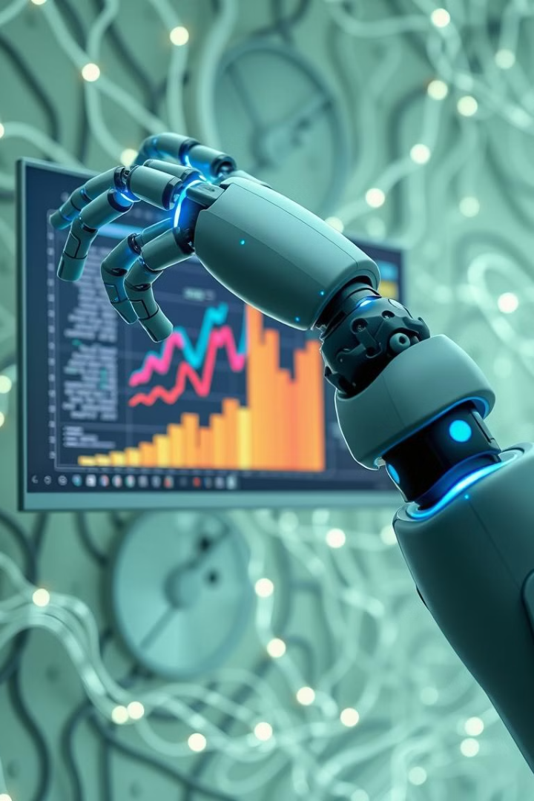

How AI Revolutionizes Supply Chain Forecasting
Data Collection
AI systems gather data from diverse sources, including historical sales, market trends, and external factors.
$$¨$$
Pattern Recognition
Machine learning algorithms analyze patterns and trends in data to identify potential disruptions and predict future demand.
Scenario Modeling
AI simulates different scenarios and generates forecasts under various conditions, providing a range of possibilities.
Continuous Optimization
AI models continuously learn and adapt to changing conditions, improving accuracy over time.

Slide 5
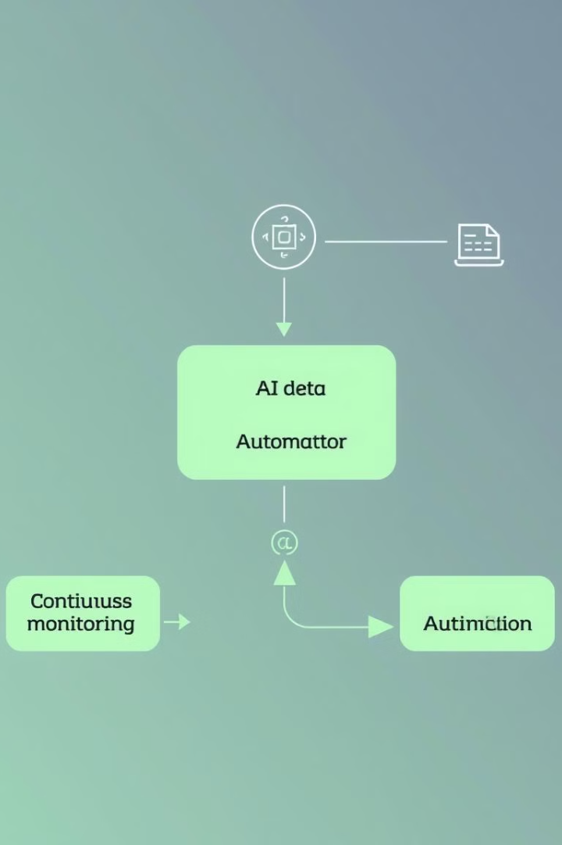
Integrating AI into Your Supply Chain Processes
Data Integration
Connect data sources across different systems and departments to create a unified view of the supply chain.
Model Deployment
Implement AI models and algorithms within your existing systems or through dedicated platforms.
Process Automation
Automate repetitive tasks, such as order fulfillment, inventory management, and supply chain planning.
Continuous Monitoring
Track AI model performance and make adjustments as needed to ensure accuracy and effectiveness.

Slide 6
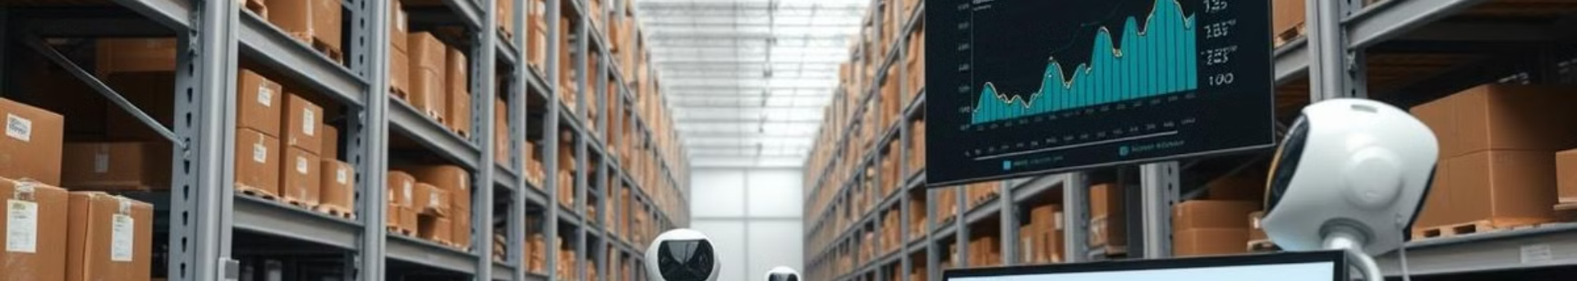




Leveraging Machine Learning for Inventory Optimization
Demand Forecasting
Inventory Control
Supply Chain Planning
Cost Reduction
Predict future demand accurately based on historical data, seasonality, and other factors.
Optimize inventory levels, minimize stockouts and overstocking, and reduce storage costs.
Plan for disruptions, optimize transportation routes, and ensure timely delivery of goods.
Minimize holding costs, transportation costs, and other expenses associated with inventory management.

Slide 7
Improving Demand Forecasting and Inventory Planning
Historical Data Analysis
Real-Time Data Integration
Analyze past sales data, seasonality, and other historical trends to identify patterns and trends.
Integrate data from diverse sources, including sales data, market reports, and customer feedback.
1
2
3
4
External Factors Consideration
Scenario Planning and Simulation
Account for economic indicators, market trends, and geopolitical events that may impact demand.
Simulate different scenarios to assess potential disruptions and adjust inventory levels accordingly.

Slide 8




Overcoming Adoption Barriers and Implementation Considerations
Data Quality
1
Ensure data accuracy and completeness for AI models to deliver reliable insights.
Technology Integration
2
Integrate AI systems seamlessly with existing infrastructure and business processes.
Change Management
3
Address employee concerns and provide training to facilitate a smooth transition to AI-driven operations.
Security and Privacy
4
Implement robust security measures to protect sensitive data and ensure compliance with regulations.

Slide 9
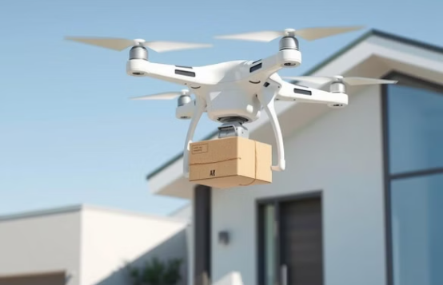
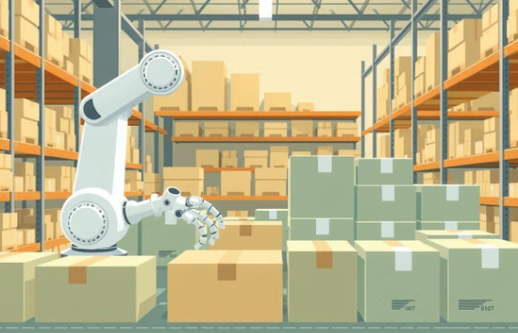

The Future of AI in Supply Chain Resilience

